Slide 1

Chapter 15
Multicasting and
Multicast Routing Protocols
Objectives
Upon completion you will be able to:
Differentiate between a unicast, multicast, and broadcast message
Know the many applications of multicasting
Understand multicast link state routing and MOSPF
Understand multicast link state routing and DVMRP
Understand the Core-Based Tree Protocol
Understand the Protocol Independent Multicast Protocols
Understand the MBONE concept

Slide 2
15.1 UNICAST, MULTICAST,
AND BROADCAST
A message can be unicast, multicast, or broadcast. Let us clarify these terms as they relate to the Internet.
The topics discussed in this section include:
Unicasting
Multicasting
Broadcasting
Multicasting versus Multiple Unicasting

Slide 3
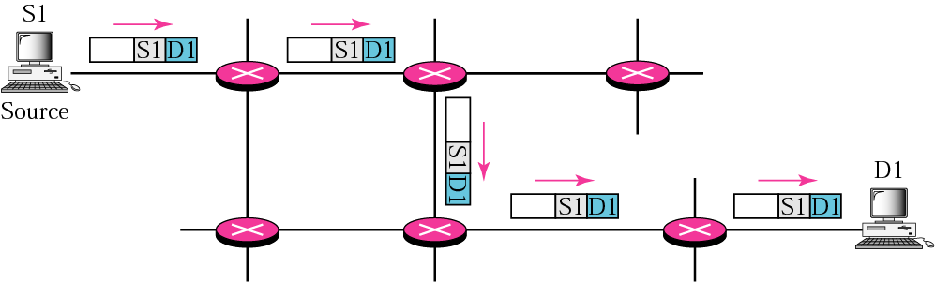
Figure 15.1 Unicasting

Slide 4

Note:
In unicasting, the router forwards the received packet through only
one of its interfaces.

Slide 5
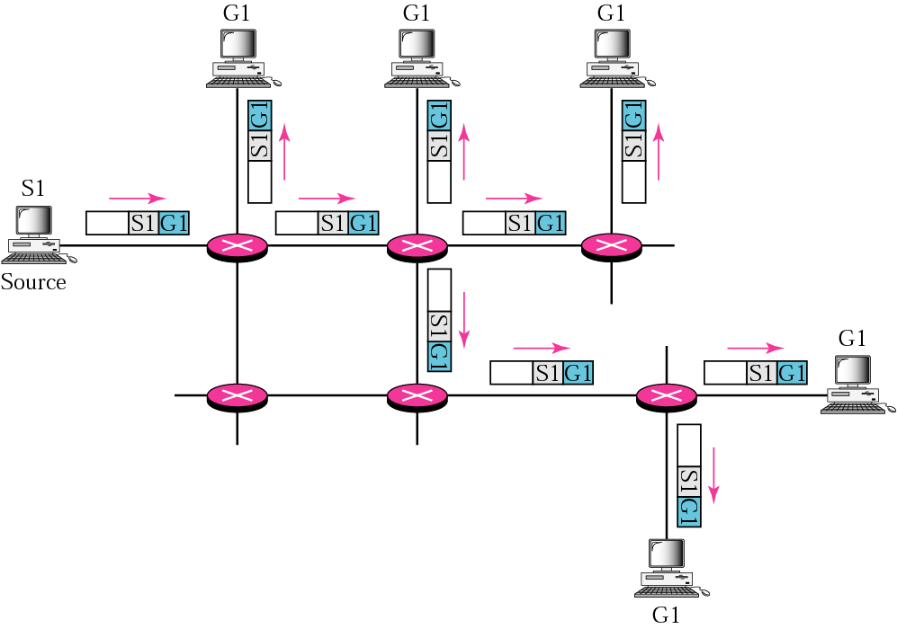
Figure 15.2 Multicasting

Slide 6
Note:
In multicasting, the router may forward the received packet
through several of its interfaces.

Slide 7
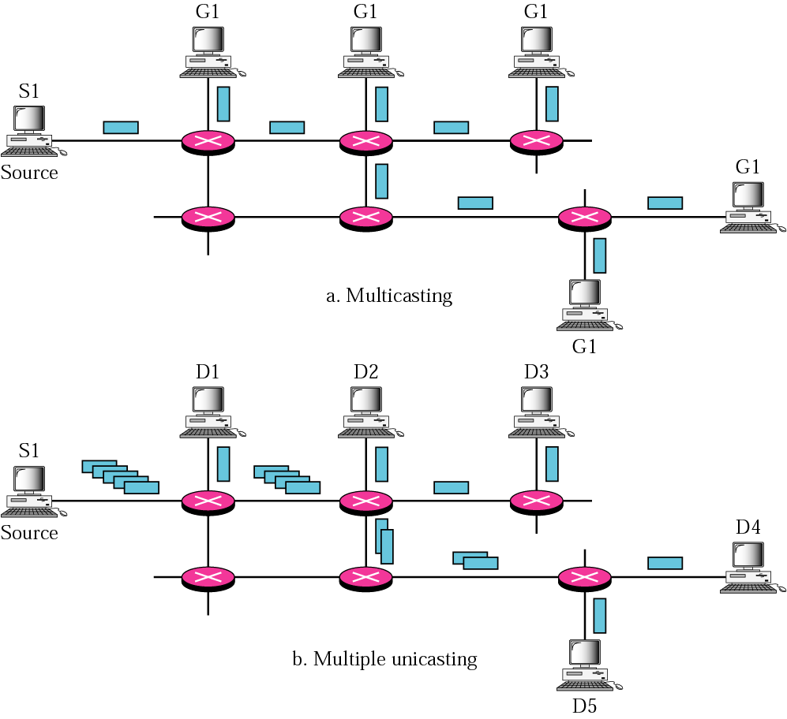
Figure 15.3 Multicasting versus multiple unicasting

Slide 8
Note:
Emulation of multicasting through multiple unicasting is not efficient and may create long delays, particularly with a large group.

Slide 9
15.2 MULTICAST APPLICATIONS
Multicasting has many applications today such as access to distributed databases, information dissemination, teleconferencing, and distance learning.
The topics discussed in this section include:
Access to Distributed Databases
Information Dissemination
Dissemination of News
Teleconferencing
Distance Learning

Slide 10
15.3 MULTICAST ROUTING
In this section, we first discuss the idea of optimal routing, common in all multicast protocols. We then give an overview of multicast routing protocols.
The topics discussed in this section include:
Optimal Routing: Shortest Path Trees
Routing Protocols

Slide 11
Note:
In unicast routing, each router in the domain has a table that defines a shortest path tree to possible destinations.

Slide 12
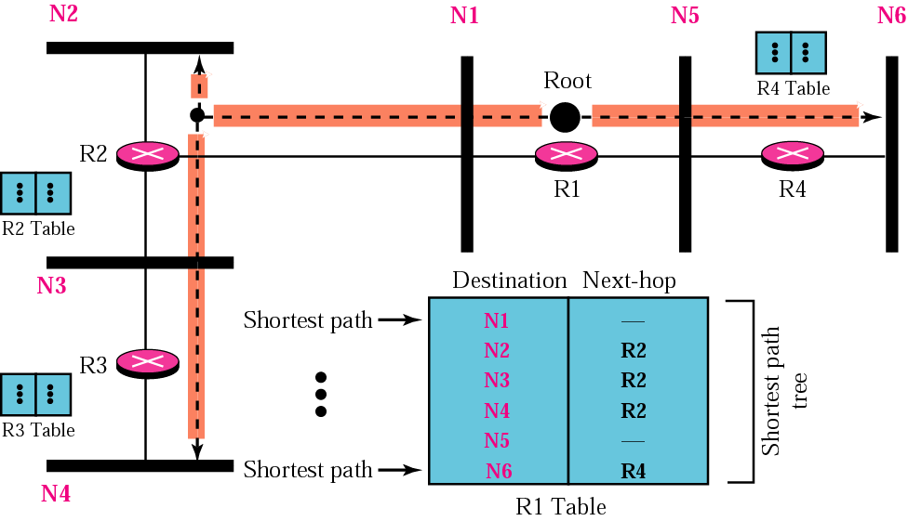
Figure 15.4 Shortest path tree in unicast routing

Slide 13
Note:
In multicast routing, each involved router needs to construct a shortest path tree for each group.

Slide 14
Note:
In the source-based tree approach, each router needs to have one shortest path tree for each group.

Slide 15
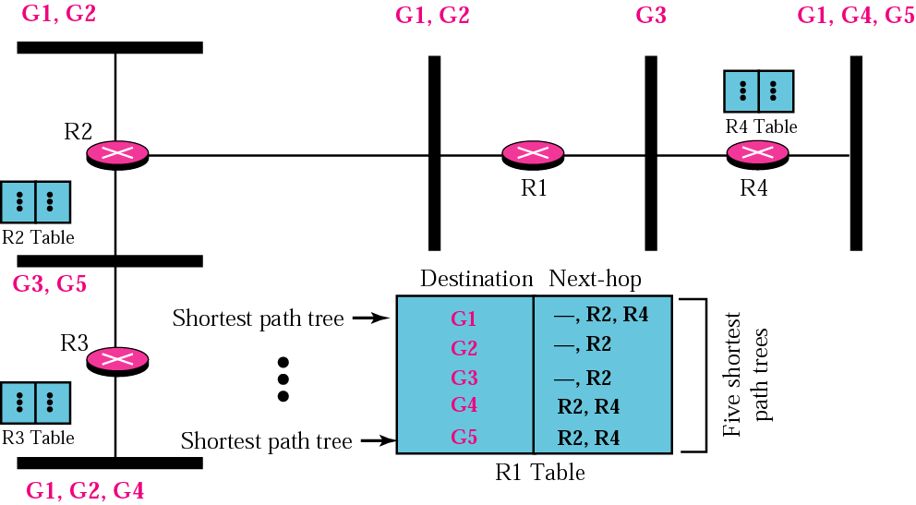
Figure 15.5 Source-based tree approach

Slide 16
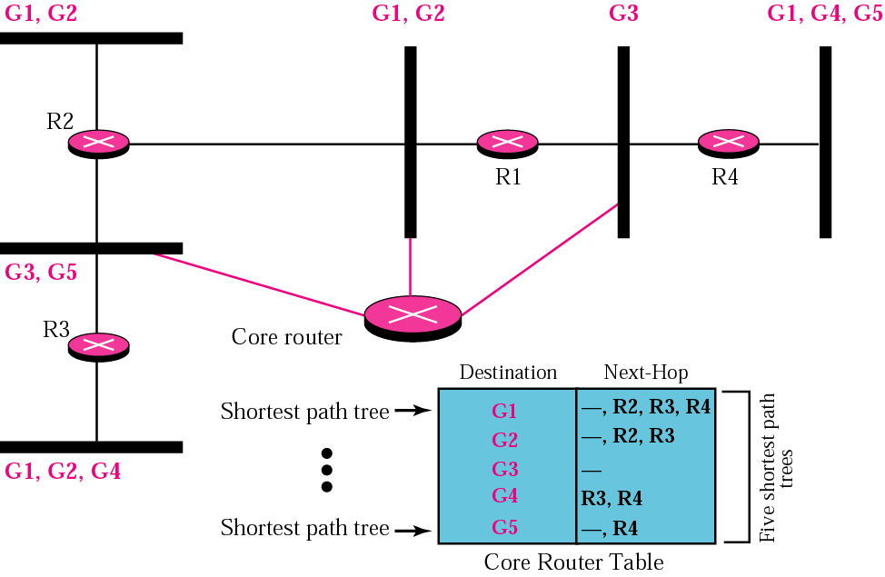
Figure 15.6 Group-shared tree approach

Slide 17
Note:
In the group-shared tree approach, only the core router, which has a shortest path tree for each group, is involved in multicasting.

Slide 18
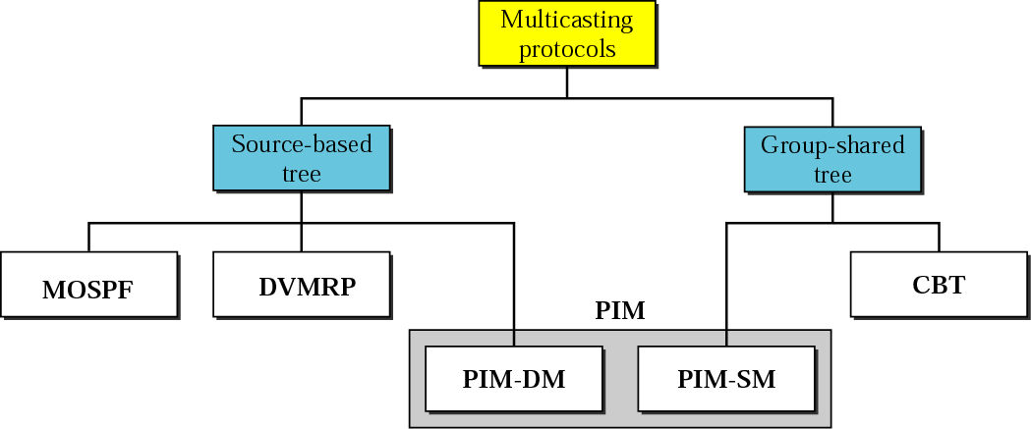
Figure 15.7 Taxonomy of common multicast protocols

Slide 19
15.4 MULTICAST LINK STATE
ROUTING: MOSPF
In this section, we briefly discuss multicast link state routing and its implementation in the Internet, MOSPF.
The topics discussed in this section include:
Multicast Link State Routing
MOSPF

Slide 20
Note:
Multicast link state routing uses the source-based tree approach.

Slide 21
15.5 MULTICAST DISTANCE
VECTOR: DVMRP
In this section, we briefly discuss multicast distance vector routing and its implementation in the Internet, DVMRP.
The topics discussed in this section include:
Multicast Distance Vector Routing
DVMRP

Slide 22
Note:
Flooding broadcasts packets, but creates loops in the systems.

Slide 23
Note:
RPF eliminates the loop in the flooding process.

Slide 24
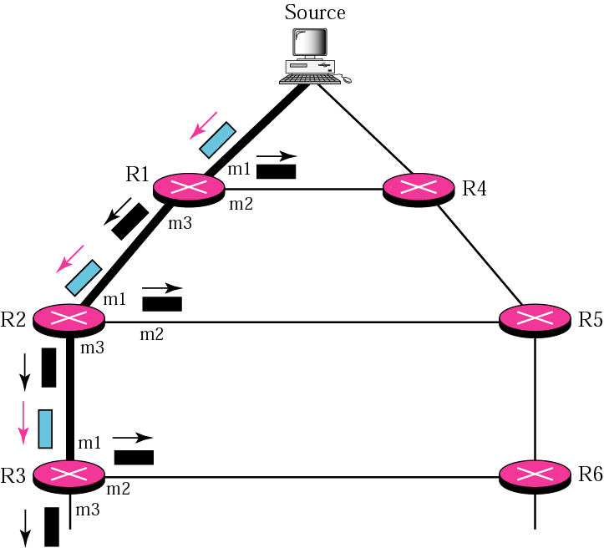
Figure 15.8 RPF

Slide 25
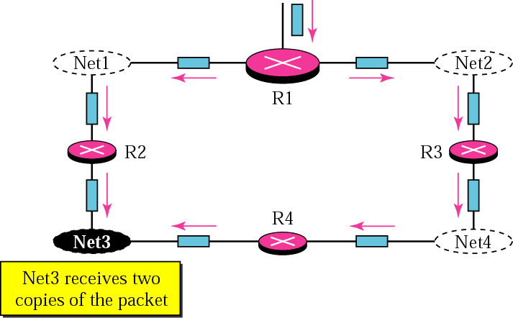
Figure 15.9 Problem with RPF

Slide 26
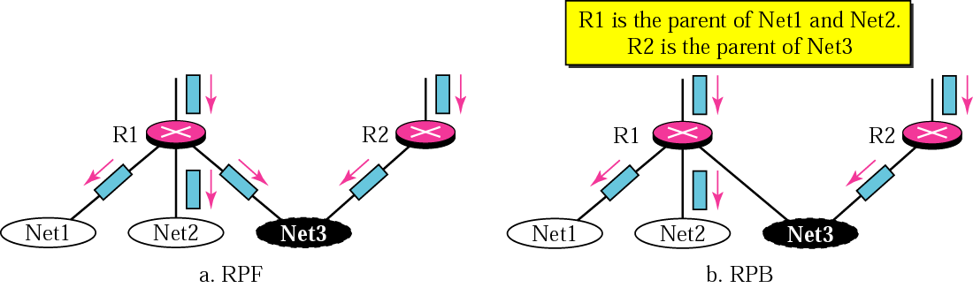
Figure 15.10 RPF versus RPB

Slide 27
Note:
RPB creates a shortest path broadcast tree from the source to each destination.
It guarantees that each destination receives one and only one
copy of the packet.

Slide 28
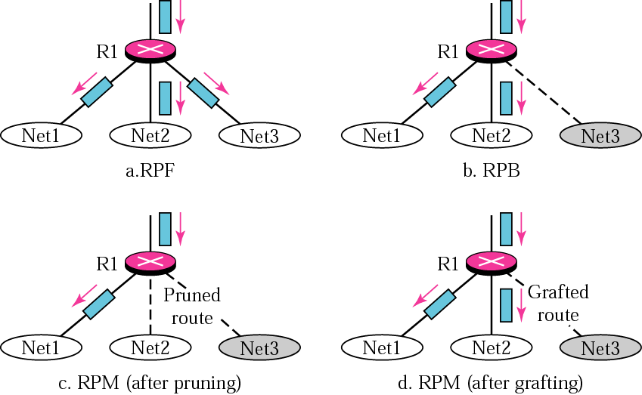
Figure 15.11 RPF, RPB, and RPM

Slide 29
Note:
RPM adds pruning and grafting to RPB to create a multicast shortest path tree that supports dynamic membership changes.

Slide 30
15.6 CBT
The Core-Based Tree (CBT) protocol is a group-shared protocol that uses a core as the root of the tree. The autonomous system is divided into regions and a core (center router or rendezvous router) is chosen for each region.
The topics discussed in this section include:
Formation of the Tree
Sending Multicast Packets
Selecting the Rendezvous Router

Slide 31
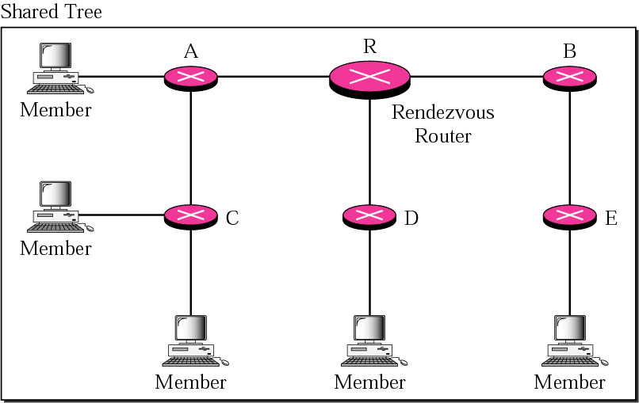
Figure 15.12 Group-shared tree with rendezvous router

Slide 32
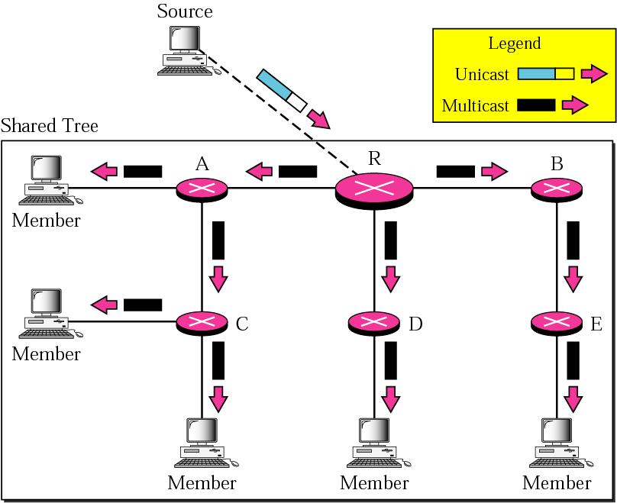
Figure 15.13 Sending a multicast packet to the rendezvous router

Slide 33
Note:
In CBT, the source sends the multicast packet (encapsulated in a unicast packet) to the core router.
The core router decapsulates the packet and forwards it to all interested interfaces.

Slide 34
15.7 PIM
Protocol Independent Multicast (PIM) is the name given to two independent multicast routing protocols: Protocol Independent Multicast, Dense Mode (PIM-DM) and Protocol Independent Multicast, Sparse Mode (PIM-SM).
The topics discussed in this section include:
PIM-DM
PIM-SM

Slide 35
Note:
PIM-DM is used in a dense multicast environment, such as a LAN.

Slide 36
Note:
PIM-DM uses RPF and pruning/grafting strategies to handle multicasting.
However, it is independent from the underlying unicast protocol.

Slide 37
Note:
PIM-SM is used in a sparse multicast environment such as a WAN.

Slide 38
Note:
PIM-SM is similar to CBT but uses a simpler procedure.

Slide 39
15.8 MBONE
A multicast router may not find another multicast router in the neighborhood to forward the multicast packet. A solution for this problem is tunneling. We make a multicast backbone (MBONE) out of these isolated routers using the concept of tunneling.

Slide 40
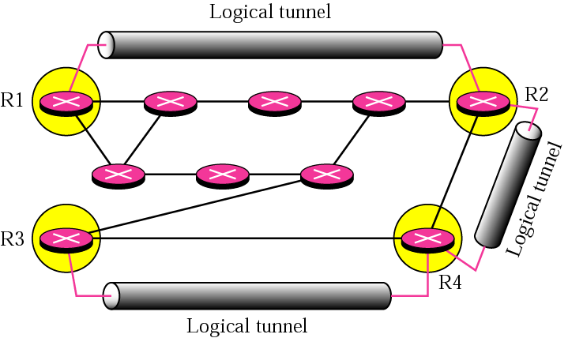
Figure 15.14 Logical tunneling

Slide 41
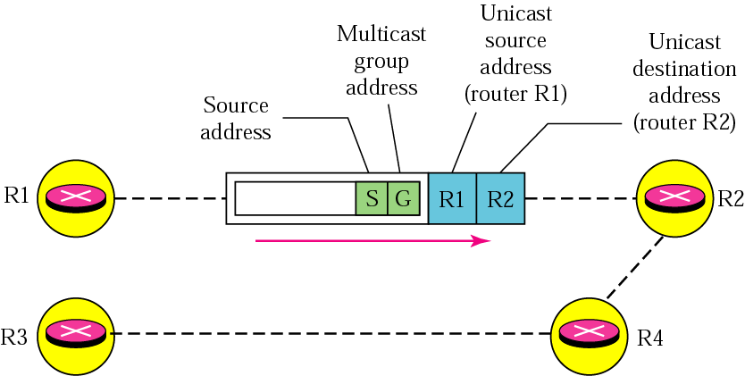
Figure 15.15 MBONE

